Slide 1
Design and Integration of Software Systems
Week 2: Distributed Systems
Models and Architectures
1-<number>

Slide 2
Lecture Plan
    Distributed System Models
      Architectural models vs. Fundamental models
      Software as a service
      Software as a component
    Architectures of Distributed Systems
    Design Requirements
    Fundamental Models
1-<number>

Slide 3
Distributed System Models
Architectural models
  Architecture: structure of separately specified components
    Architectural models define what different components exist and the relationships between these components - e.g., protocol layers, clients, servers, peers, etc.
Fundamental models
  Fundamental Model: Formal description of system properties common in all architectural models
    Fundamental models are described using interaction graphs, process workflows, dataflows, etc.
1-<number>

Slide 4
Software as a service: Layers and Services
Basic idea to break up the complexity of systems by designing them through layers and services
  layer: group of closely related and highly coherent functionalities
  service: functionality provided to a superior layer
Examples of layered architectures
  operating systems (kernel, adapters,
  drivers, services, etc.)
  computer network protocols
  (application protocol, process
  interaction protocol, data transport
  protocol, etc.)
layer n+1
n-service
layer n
n-1 -service
layer n-1
1-<number>

Slide 5
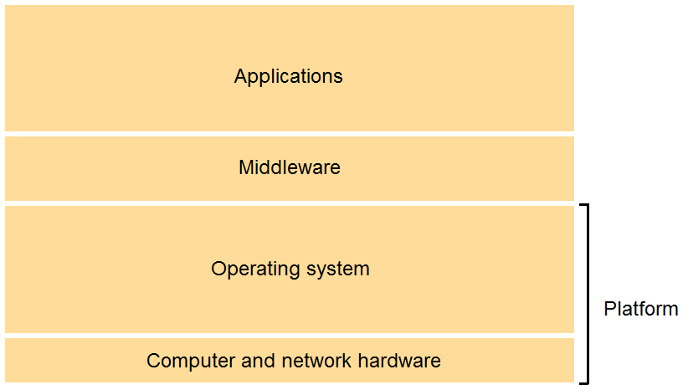
Software Service Layers
1-<number>

Slide 6
Software Service Layers
Platform: Operating system and hardware
  Supplies system programming interface
  Windows 8 / Intel Core i5 processor
  Solaris / SPARC processor
Middleware: “a layer of software whose purpose is to mask heterogeneity and to provide a convenient programming model for programmers”
  Supplies the application programming interface
  Can also provide services such as: Naming, Security, Transactions, Persistent storage, Event notification, …
1-<number>

Slide 7
Software Service Layers
Limitations on the use of Middleware
The end-to-end argument [Saltzer et al, 1984]
  Some functions can only be correctly implemented with the help of application level information
  Therefore providing such functionality as a feature of the communication system is not possible
  Even if the data communication system is extraordinarily reliable it does not reduce the burden on the application program to ensure reliability at application level
1-<number>

Slide 8
Software as a component: Objects and Interfaces
The functions available for invocation in a process are specified by one or more interface definitions.
With Client/Server applications each server provides services which can be invoked via its interfaces
We create programs in Java, C++, C#, and other OO programming languages based on object interfaces
Middleware allows remote services to be represented to the outside as remote methods which can be called via remote object references.
Client/Server services are (typically) statically allocated, whereas, Distributed Object services are (typically) dynamically allocated.
1-<number>

Slide 9
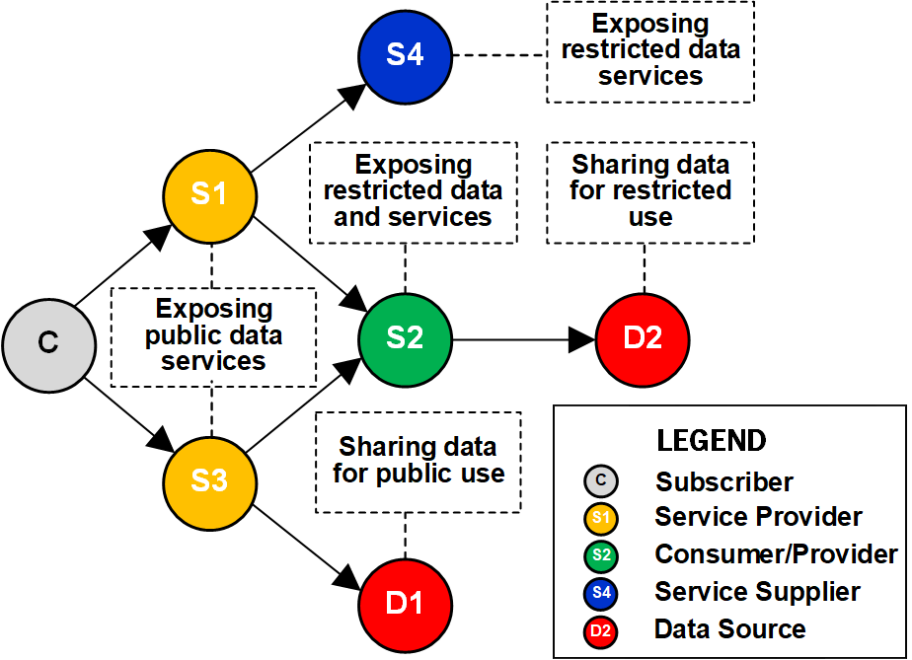
Software service components
1-<number>

Slide 10
Lecture Plan
    Distributed System Models
    Architectures of Distributed Systems
      Client-Server Model
      Peer-to-Peer Model
      Multi-agent Model
    Design Requirements
    Fundamental Models
1-<number>

Slide 11
Architectural Models
Functions of individual components is abstracted away
Architectural models consider instead the patterns for communication and workload distribution
Distinction between client, server and peer processes
  Assessment of workload
  Failure impact analysis
Overall goal: structure should meet demands on
  Reliability
  Manageability
  Adaptability
  Cost-effectiveness
1-<number>

Slide 12
System Architectures
Client-server
PUSH
Multiple servers
Proxy server
Peer-to-peer
Network computers and thin clients
Mobile code and mobile agents
Mobile devices and spontaneous interoperation
1-<number>

Slide 13
Client-Server Model
Client
invocation
result
Server
result
Server
invocation
Client
Key:
Process:
Computer:
1-<number>

Slide 14
Client-Server Model
Client: Process wishing to access data, use resources or perform operations on a different computer
Server: Process managing data and all other shared resources amongst servers and clients, allows clients an access to resource and performs computation
Interaction: invocation / result message pairs
Example
  HTTP client (browser) requests page from HTTP server
  HTTP Server delivers page
1-<number>

Slide 15

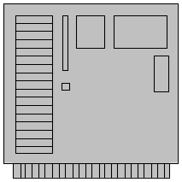
Client-Server Model
Multitier architectures (2-tier, 3-tier, n-tier) are special cases of the client-server model where multiple tiers increase the scalability of the service
In 3-tier architecture components are divided for tasks of
  1. data representation
  2. data processing
  3. data storage
3. Data storage
tier
1. UI tier
Database
2. Application
logic tier
1-<number>

Slide 16
Extended Client-Server Model
(Push Model)
Server push model
  Server initiates dialogue
  “Pushes” information to client
  Client needs application that listens for server pushes
Example - Server push model
  Wireless Application Protocol (WAP) push messages
  SMS text messages (works on both wireless and wired networks – i.e., Twitter)
1-<number>

Slide 17
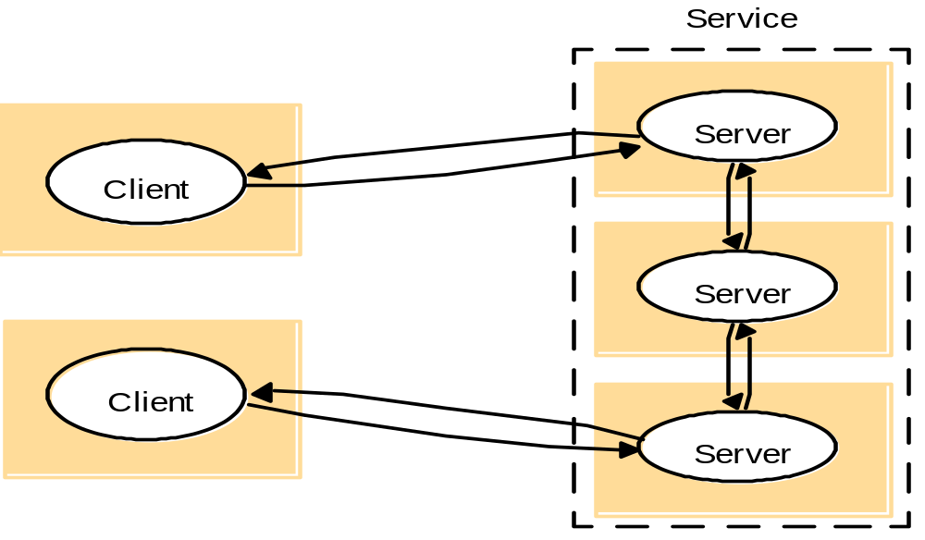
Multiple Servers
1-<number>

Slide 18
Multiple Servers
Description
Services may be provided by multiple servers
Partitioned or replicated service-related objects
Replication provides
  Increased performance, availability and fault-tolerance
But requires replica coordination / consistency preservation
Examples
high available web servers (portals, download centers), information services
1-<number>

Slide 19
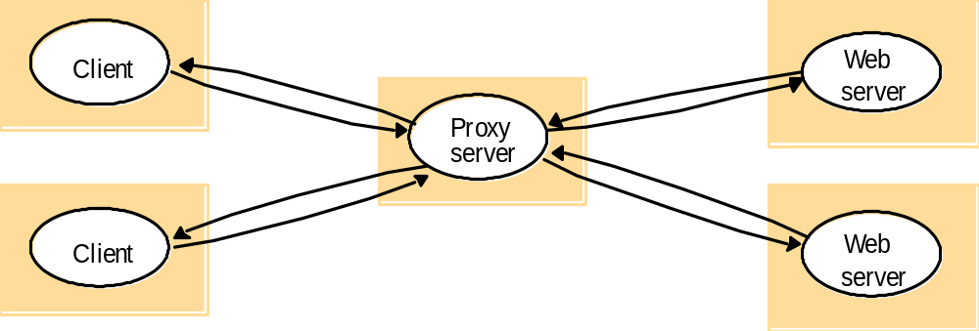
Proxy Server and Caches
1-<number>

Slide 20
Proxy Server and Caches
Cache: a close store of recently used data
  Considerably increases performance in many applications
  But requires cache coherence protocols
Proxy server: a shared cache of resources
  Renders replication/distribution transparent
  Most commonly used for web access
  In contrast to three-tier architecture, proxy only caches data and does not process it
1-<number>

Slide 21
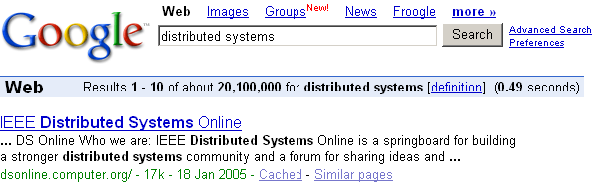
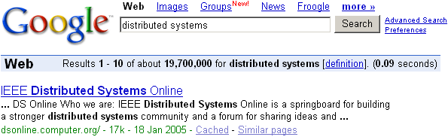
Proxy Server and Caches
Frequently used in search-engines
1-<number>

Slide 22
Network Computers / Thin Clients
Network Computer
All files stored remotely
Minimum of local software and hardware
Any local disk used mainly as a cache
Thin Client
Supports a windows-based UI in a local computer
User can execute applications on a remote computer locally
Low management, low hardware costs
The code is performed on the computer server (host)
Can suffer from both network and OS latencies
Example of thin clients
X-11 window system in Unix
Web browsers in C/S architecture
1-<number>

Slide 23
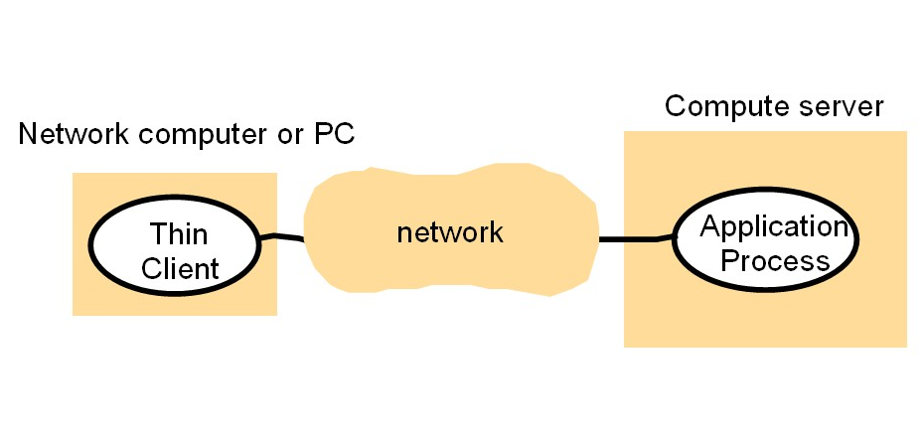
Network Computers / Thin Clients
1-<number>

Slide 24
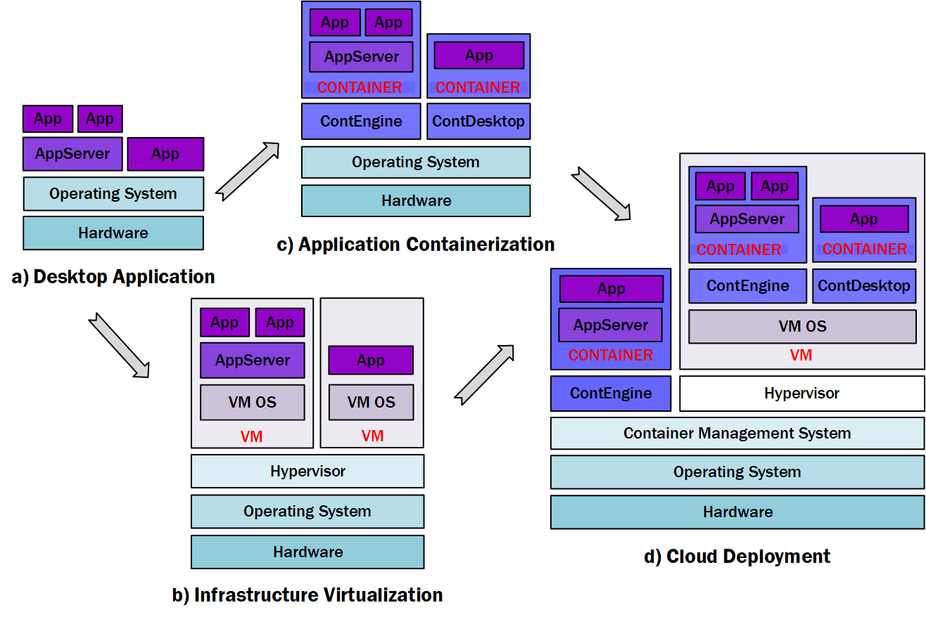
From server on the desktop to portal on the cloud
1-<number>

Slide 25
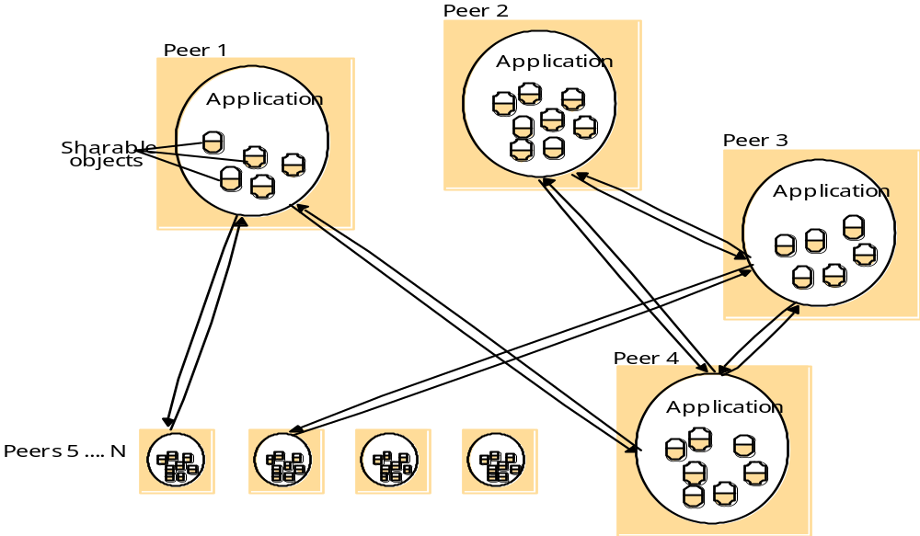
Peer-to-Peer Model
1-<number>

Slide 26
Peer-to-Peer Model
Description
Peer processes: processes have similar roles
  No absolute distinction between client/server
  Peer can be both a client and a server
Reduces inter-process comm delay for local object access
Increased fault-tolerance and scalability
  No single point-of-failure, no performance bottleneck
With no central control coordination can be difficult
Examples
distributed search, routing, news servers
1-<number>

Slide 27
Mobile Agents
Description
Running program (code and date)
Travels from one computer to another in the network
Performs tasks on some other processes behalf
Can access local resource at the computer it visits
Examples
Can be used to install and maintain software.
Compare prices of products from vendors by visiting their sites and do a series of database operations
Virus, worms
1-<number>

Slide 28
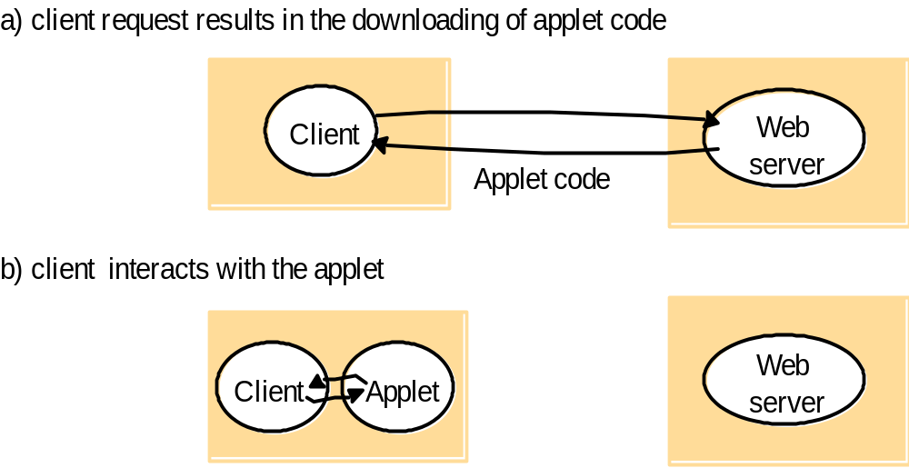
Mobile Code
1-<number>

Slide 29
Mobile and IoT Devices
Description
Hardware computing components
Move between physical locations
Can lead to spontaneous computation and inter-operation
Service Discovery is important
Example
Smartphone
Laptops, Digital cameras
Smart watches, GPS receiver, ….
1-<number>

Slide 30
Lecture Plan
    Distributed System Models
    Architectures of Distributed Systems
    Design Requirements
      Performance issues
      Quality of Service
    Fundamental Models
1-<number>

Slide 31
Design Requirements
Performance Issues
These arise from the limited processing and communication capacities of computers and networks
To achieve good responsiveness, systems must be composed of relatively few software layers, and the quantities of data transferred between the client and server must be small
The throughput of the intervening software layers is important, as well as that of the network
Load balancing is important and can involve moving partially completed work as the loads on host change
1-<number>

Slide 32
Design Requirements
Quality of Service (QoS)
Reliability, security and performance can effect the quality of service experienced by clients and users
QoS quantifiers include responsiveness, computational throughput and timeliness guarantees
QoS refers to the network, applications and operating systems within the system
1-<number>

Slide 33
Lecture Plan
    Distributed System Models
    Architectures of Distributed Systems
    Architectural Design Requirements
    Fundamental Models
      Interaction Model
      Failure Model
      Security Model
1-<number>

Slide 34
Fundamental Models
Fundamental models are concerned with the main elements of the system and their characteristics that effect the individual and collective behavior of the system as a whole regardless its architecture
  What are the elements of the system and how do they communicate?
  What are the events and how do the elements get notified?
  What are the errors and how do they propagate through the elements?
  How secure is the interaction and how the elements support it?
Architectural models are not fundamental – they are design artifacts!
1-<number>

Slide 35
Fundamental Models
Interaction Model
Distributed systems are composed of components which run multiple processes and are therefore more complex than single process systems
Distributed algorithms are required to define the steps to take when interaction between the processes occurs
The interaction of distributed systems requires additional factors to be considered, i.e. communication channel performance and global notion of time.
1-<number>

Slide 36
Interaction Model
Communication Channel Performance
Latency – the delay between the start of a message’s transmission from one process and the beginning of its receipt at another
  Access delay in establishing a connection
  Operating system delay can occur due to current OS load
Bandwidth – the total amount of information that can be transmitted over a given time unit
Jitter – variation in time taken to deliver a series of messages
1-<number>

Slide 37
Interaction Model
Global Notion of Time
Within distributed systems you cannot depend on global clocks
A collection of synchronised clocks can all provide different time values
Clock Drift Rate – how much a clock varies from some starting point
1-<number>

Slide 38
Interaction Model
Event Ordering
If we cannot depend on a notion of ‘global time’, what do we do to ensure correct processing order?
We depend on the ordering of events
The execution of a system can be described in terms of events and their ordering despite the lack of accurate clocks
logical time allows the order in which messages are presented to be inferred without using clocks
1-<number>

Slide 39
Fundamental Models
Failure Model
Both processes and communication channels may fail
A failure model defines the ways in which failure may occur in order to provide an understanding of the effects of the failure
Most failures in a distributed system are benign
Common failure types – omission, arbitrary failure and timing failure
1-<number>

Slide 40
Failure Model
Omission Failures
An omission failure is when a process or communication channel fails to perform actions that it is supposed to.
Major cause of omission failure is that processes can crash
A service is said to ‘crash cleanly’ if its processes either function correctly or else stop.
A timeout can indicate that a process is not responding
  Has the process crashed or is it running slow?
  Have timeout messages to/from the process been lost?
1-<number>

Slide 41
Failure Model
Arbitrary Failures
Failures are arbitrary (or ‘Byzantine’) – any type of error can occur at any time.
A process can arbitrarily omit an intended processing step or take unintended processing steps
Arbitrary failures of communication channels are rare
1-<number>

Slide 42
Failure Model
Timing Failures
Applies to synchronous and asynchronous distributed systems.
Servers may respond too slowly
Real-time operating systems can help
Most general-purpose operating systems cannot meet real-time constraints
Particularly relevant to distributed multimedia systems
1-<number>

Slide 43
Failure Model
Fault Tolerant Systems
It is not possible to completely avoid failures, but it is possible to build reliable systems using
  Duplication (i.e., replicating the messages)
  Repetition of the operations (i.e., retransmitting)
  Adding control information to the messages (e.g., checksums added to a packet).
In communication channels this provides:
  Validity: Any message in an outgoing buffer will be received by an incoming buffer (guarantees delivery).
  Integrity: Messages sent are identical to message received, messages are only delivered once (guarantees correct messages, and no duplicates)
1-<number>

Slide 44
Fundamental Models
Security Model
The security of a distributed system can be achieved by securing the processes and the channels used for their interactions and by protecting the objects that they encapsulate against unauthorised access
  Encryption - scrambling a message to hide its contents
  Identification – assigning an unique identifier to a recognized entity
  Authentication - assuring the true identity of an entity
  Authorization – allowing an entity to access specific data and/or to perform a specific operation
1-<number>

Slide 45
Security Model
Attacks
Process Attacks:
  Man in the middle: enemy can send a message, disguised as a real user
    Servers cannot determine if requests are real
    Clients cannot determine if responses are real
  Can be defeated by encryption and authorization
Communication Channel Attacks:
  Eavesdropping: Enemy can intercept, copy, alter, and inject messages. Can save valid messages and replay them later.
  Defeated through the use of secure channels
Other Attacks:
  Denial of Service (DoS): Enemy keeps invoking services, trying to overwhelm it (also DDoS)
  Trojan Horses: Malicious code disguised as legitimate.
1-<number>

Slide 46
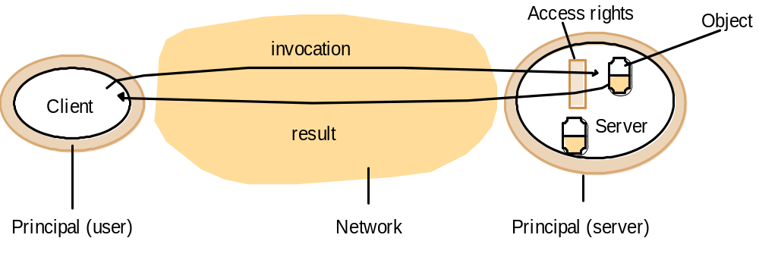
Security Model
Processes and communications
1-<number>

Slide 47
Security Model
Attacks
Copy of
m
The enemy
m’
Process
p
m
Process
q
Communication channel
Threats to processes
Threats to communication channels
Denial of service threats
1-<number>

Slide 48
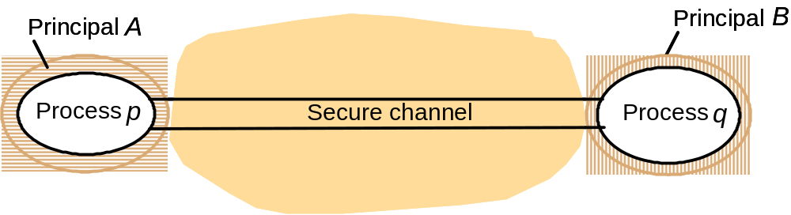
Security Model
Secure Channels
Encryption and authorization are used to build secure channels as a service layer on top of existing communication services.
Both processes are used to control the access
1-<number>

Slide 49
Summary
  What we have covered in this lecture:
  Distributed System Models
  Architectures of Distributed Systems
  Architectural Design Requirements
  Fundamental Models
  Next week:
  TCP Sockets and Socket Programming
1-<number>

